Slide 1
Introduction to Tuning Models
Geoff Hulten

Slide 2
Overview of Model Tuning
Goal: get the highest generalization accuracy you can
Understand the Application
Basic Feature / Data Engineering
Plan a Hyperparameter
tuning run
Execute the tuning run
Relax, drink coffee, don’t stress
Need to balance
The data you have
Concept complexity
Feature engineering
Model type & parameters
Bias / Variance
Computational realities
Iterate
Train with best hyperparameters on train + validate + test
Visualize and interpret the output
Celebrate!
Ship the model
Run model on test set

Slide 3
The Application – Blink Detection
Bangs
12x12
Distortion
Label eyes as opened or closed
~4500 images
24x24 grey scale
Anything interesting we see in the data?
Modeling issues in data?
Baseline Accuracy
Single layer fully connected 5 nodes
~89% accuracy
6x6
Hard to Tell
Safe Augment with Flip
Glasses
Shark Eye

Slide 4
Neural Network Structure (~LeNet)
Network Parameters:
$N_{1}$ – Filter Size Layer 1
$F_{1}$ – Num Filters Layer 1
$N_{2}$ – Filter Size Layer 2
$F_{2}$ – Num Filters layer 2
$H$ – Num Hidden Nodes
$D$ – Use Dropout 0/1
2nd Conv Block Optional
Input
24 x 24
Conv Layer
$N_{1}$x $N_{1}$x${ F}_{1}$
Max Pooling
12 x 12 x $F_{1}$
Conv Layer
$N_{2}$ x $N_{2}$x $F_{2}$
Max Pooling
6 x 6 x $F_{2}$
Hidden Layer
H
Output Layer
(sigmoid)
Dropout
P(open)
$N_{1}$ – dim
$N_{2}$ – dim
H – hidden nodes
12 x 12 after pooling
6 x 6 after pooling
Other Parameters:
Loss Function Convergence
Data Processing
$F_{1}$ – num Filters
$F_{2}$ – num Filters
Batch norm & ReLU activation used in conv layers

Slide 5
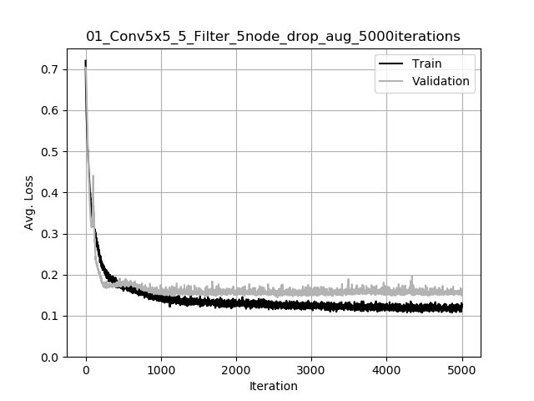
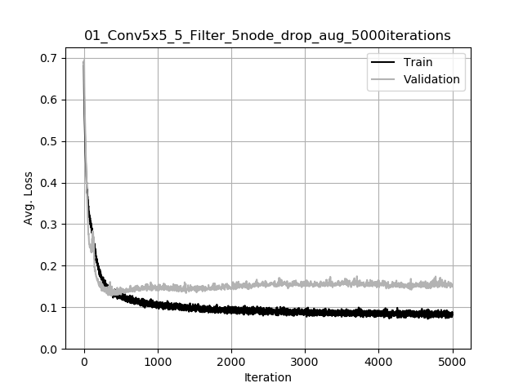
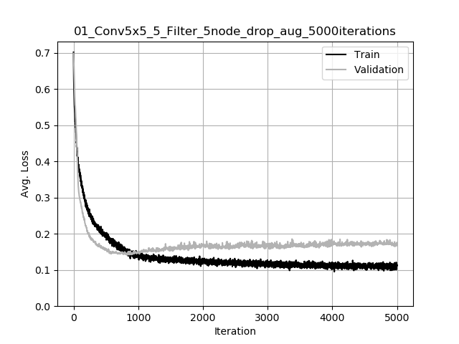
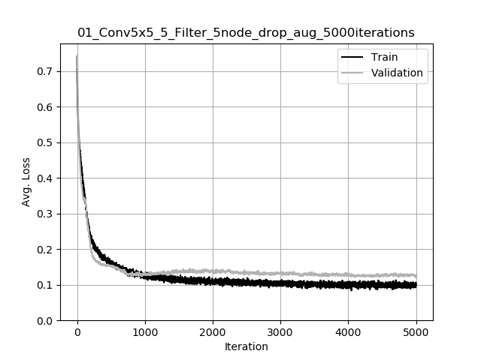
What’s hard about this?
Too many parameter settings…
$N_{1}$ – Filter Size Layer 1 → 4-5 reasonable values
$F_{1}$ – Num Filters Layer 1 → 10-20 settings
$N_{2}$ – Filter Size Layer 2 → 4-5 reasonable values
$F_{2}$ – Num Filters layer 2 → 10-20 settings
$H$ – Num Hidden Nodes → 10-20 settings
$D$ – Use Dropout 0/1 → 2 values
Loss Function → 2-4 values
Convergence → ~5 settings
Data Processing → 5-10 to try…
We can’t measure settings well…
Generalization bounds: stdev on accuracy ~1%
- 5-fold cross validation improves to ~.5%
Variance because of initialization -> 10% of loss
- 5 repetitions per setting improves by factor of 2
Millions of possibilities
~5 seconds per…
Over 100 days to try them all
And this is an easy problem
And we greatly constrained neural network
1 parameter eval → 25 train/test runs → ~2 minutes

Slide 6
Types of parameter searches
Grid
Cross product of parameter settings
Systematic exploration
viable ranges, sensitivity
Slow (or impossible) to be exhaustive
Useful for getting bearings
Directed
Use human intuition to zero in on meaningful parameters
Interpret the output of each run
Chang parameters to balance overfitting vs underfitting
Use more human time vs cpu time, but if you know what you’re doing get further faster
Random Search
Randomly change a few parameters
Update if ‘better’
Run it for…a long time…
AI Directed
Learn how to interpret results and adapt
Seems like it could work
Hasn’t taken over the world yet…

Slide 7
Example of a Grid search
245 settings, 25 runs each, 3.3 hours
14 settings within 95% confidence bound of best setting
Grid Search Parameters:
$N_{1}$ – Filter Size Layer 1 → {3,5,7,9,11}
$F_{1}$ – Num Filters Layer 1 → {5,10,15,20,25,30,35}
$N_{2}$ – Filter Size Layer 2 → NONE
$F_{2}$ – Num Filters layer 2 → NONE
$H$ – Num Hidden Nodes → {5,10,15,20,25,30,35}
$D$ – Use Dropout 0/1 → TRUE
Loss Function → BCE
Convergence → Patience(5) min(50)
Data Processing → None
N1 (filterSize) | F1 (Filters) | H (Nodes)
7 | 35 | 35
7 | 35 | 10
11 | 30 | 10
5 | 15 | 30
9 | 35 | 30
7 | 35 | 25
7 | 30 | 35
9 | 25 | 20
9 | 30 | 25
7 | 35 | 30
7 | 25 | 20
7 | 30 | 20
7 | 30 | 25
9 | 30 | 5
Eliminate $N_{1}$ = 3
Behavior of $H?$
Eliminate $F_{1}$ < 20

Slide 8
Explore some Parameter Sweeps
Focus here and do more exploration:
More restarts to help variation
Further explore parameter ranges
Introduce new parameters
$$N_{1}$$

Slide 9
Grid Search Summary
Refined Parameter Ranges:
$N_{1}$ – Filter Size Layer 1 → {3,5,7,9,11}
$F_{1}$ – Num Filters Layer 1 → {5,10,15,20,25,30,35}
$N_{2}$ – Filter Size Layer 2 → NONE
$F_{2}$ – Num Filters layer 2 → NONE
$H$ – Num Hidden Nodes → {5,10,15,20,25,30,35}
$D$ – Use Dropout 0/1 → TRUE
Loss Function → BCE
Convergence → Patience(5) min(50)
Data Processing → None
Grid Search Process
Pick as many important parameters as possible
Pick viable values of the parameters
Evaluate each combination
Look parameters behavior as you sweep ranges
Get a sense of parameters:
Importance
Viable Ranges
Interactions
Refine & repeat
SLOW – Adding 2nd conv layer:
12k more parameter settings
6.7 days minimum (plus each run slower)
So many variants you’re almost guaranteed to pick a setting that isn’t best…

Slide 10
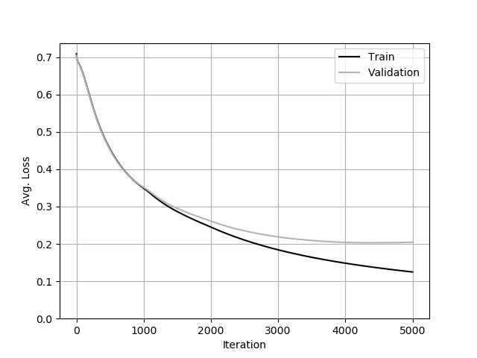
Directed Search
Check Test Set Accuracy Infrequently
Test Accuracy: 91.39%
Start with a simple parameter setting
Evaluate it
Training set loss
Validation set loss
Run beyond convergence to observe
Interpret intermediate results
Use your knowledge and intuition to adapt
Parameter Setting #1:
$N_{1}$ – Filter Size Layer 1 → NONE
$F_{1}$ – Num Filters Layer 1 → NONE
$N_{2}$ – Filter Size Layer 2 → NONE
$F_{2}$ – Num Filters layer 2 → NONE
$H$ – Num Hidden Nodes → 5
$D$ – Use Dropout 0/1 → FALSE
Loss Function → BCE
Convergence → 5000 Iterations
Data Processing → NONE
Interpretation:
High Bias, not overfitting
Next Step:
Add more power

Slide 11
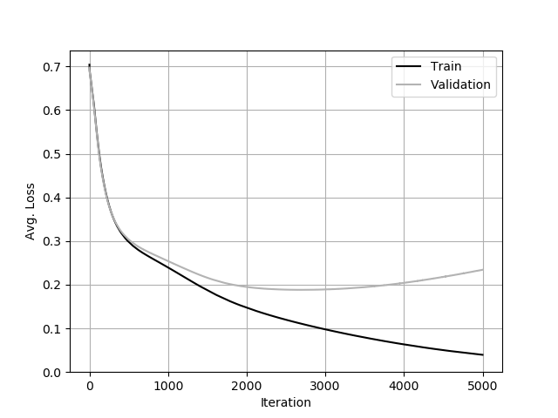
Directed Search
Previous Setting
Parameter Setting #2:
$N_{1}$ – Filter Size Layer 1 → NONE
$F_{1}$ – Num Filters Layer 1 → NONE
$N_{2}$ – Filter Size Layer 2 → NONE
$F_{2}$ – Num Filters layer 2 → NONE
$H$ – Num Hidden Nodes → 50
$D$ – Use Dropout 0/1 → FALSE
Loss Function → BCE
Convergence → 5000 Iterations
Data Processing → NONE
Interpretation:
High Bias and Overfitting
Next Step:
Model problem structure better

Slide 12
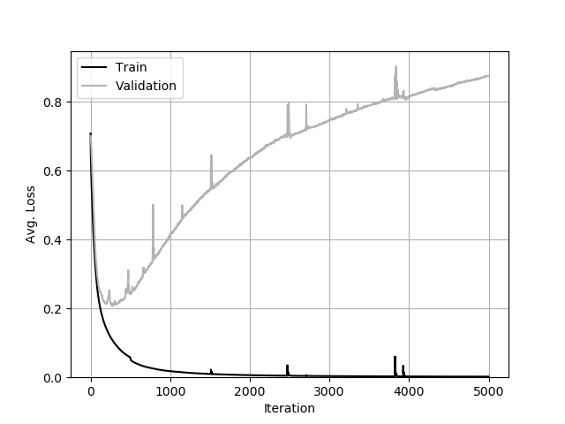
Directed Search
Previous Setting
Parameter Setting #3:
$N_{1}$ – Filter Size Layer 1 → 3x3
$F_{1}$ – Num Filters Layer 1 → 5
$N_{2}$ – Filter Size Layer 2 → NONE
$F_{2}$ – Num Filters layer 2 → NONE
$H$ – Num Hidden Nodes → 5
$D$ – Use Dropout 0/1 → FALSE
Loss Function → BCE
Convergence → 5000 Iterations
Data Processing → NONE
Interpretation:
Crazy Overfitting
Next Step:
Some Overfitting Prevention

Slide 13
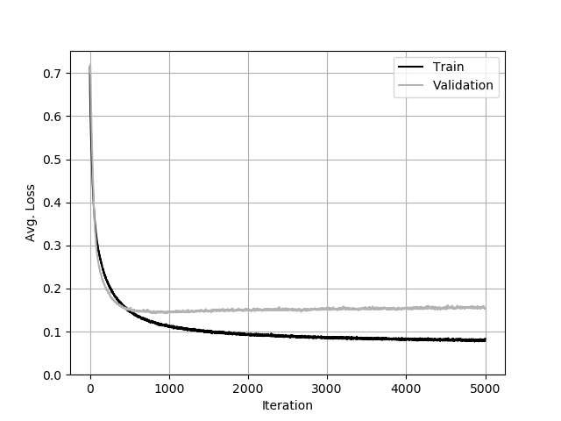
Directed Search
Previous check 91.39 – progress!
Test Accuracy: 93.95%
Previous Setting
Parameter Setting #4:
$N_{1}$ – Filter Size Layer 1 → 3x3
$F_{1}$ – Num Filters Layer 1 → 5
$N_{2}$ – Filter Size Layer 2 → NONE
$F_{2}$ – Num Filters layer 2 → NONE
$H$ – Num Hidden Nodes → 5
$D$ – Use Dropout 0/1 → True
Loss Function → BCE
Convergence → 5000 Iterations
Data Processing → Normalize
Interpretation:
Well behaved run
Next Step:
Add some power

Slide 14
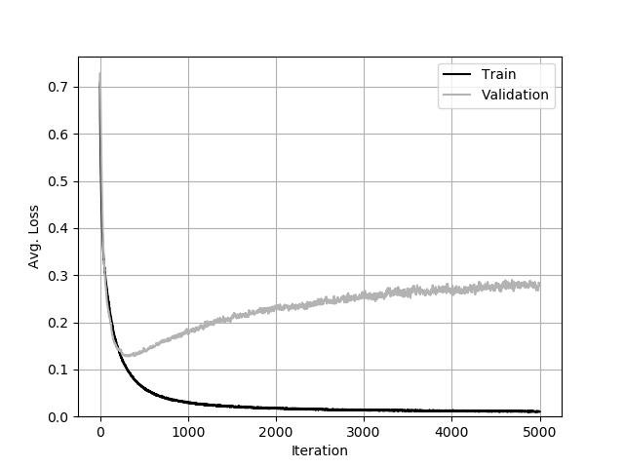
Directed Search
Previous Setting
Parameter Setting #5:
$N_{1}$ – Filter Size Layer 1 → 3x3
$F_{1}$ – Num Filters Layer 1 → 5
$N_{2}$ – Filter Size Layer 2 → NONE
$F_{2}$ – Num Filters layer 2 → NONE
$H$ – Num Hidden Nodes → 30
$D$ – Use Dropout 0/1 → True
Loss Function → BCE
Convergence → 5000 Iterations
Data Processing → Normalize
Interpretation:
Converges well, then overfits
Next Step:
Some more work to help overfitting

Slide 15
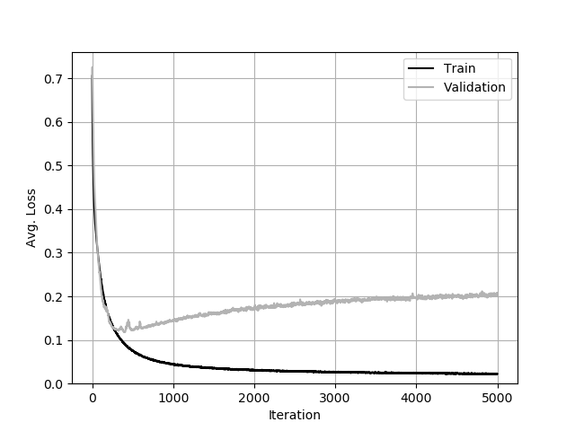
Directed Search
Test Accuracy: 94.24%
Test Accuracy: 93.69%
Previous Setting
Parameter Setting #6:
$N_{1}$ – Filter Size Layer 1 → 3x3
$F_{1}$ – Num Filters Layer 1 → 5
$N_{2}$ – Filter Size Layer 2 → NONE
$F_{2}$ – Num Filters layer 2 → NONE
$H$ – Num Hidden Nodes → 30
$D$ – Use Dropout 0/1 → True
Loss Function → BCE
Convergence → 5000 Iterations
Data Processing → Normalize, Flip Augmentation
Interpretation:
Jitter around convergence
Overall looks better
Next Step:
More power

Slide 16
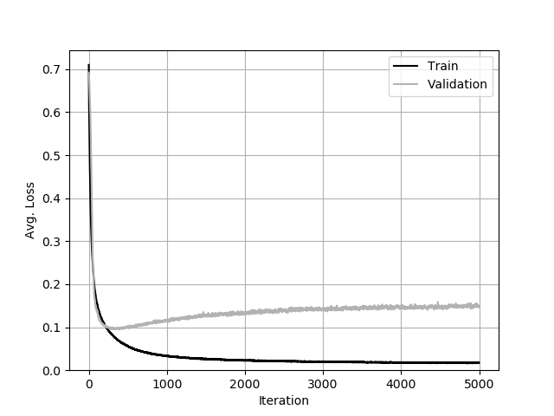
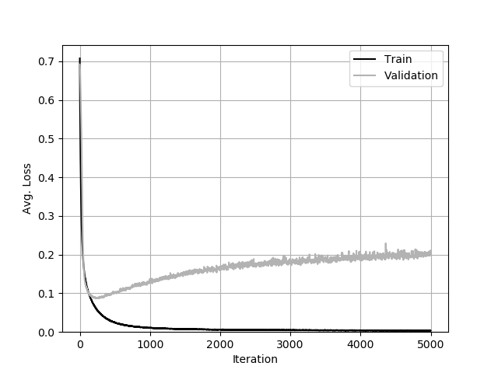
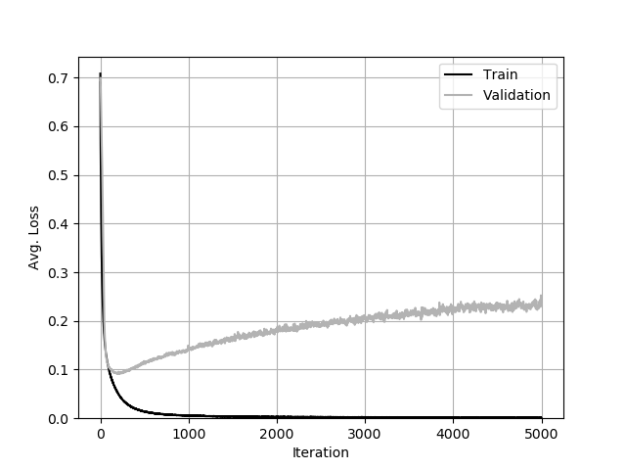
Directed Search
$$F_{2}=10$$
$$F_{2}=20$$
Previous Setting
$$F_{2}=30$$
Small sweep
Parameter Setting #7:
$N_{1}$ – Filter Size Layer 1 → 5x5
$F_{1}$ – Num Filters Layer 1 → 5
$N_{2}$ – Filter Size Layer 2 → 3x3
$F_{2}$ – Num Filters layer 2 → { 10, 20, 30 }
$H$ – Num Hidden Nodes → 30
$D$ – Use Dropout 0/1 → True
Loss Function → BCE
Convergence → 5000 Iterations
Data Processing → Normalize, Flip Augmentation
Interpretation:
Better match for problem
Good convergence properties
Next Step:
One more sweep, then check test data…

Slide 17
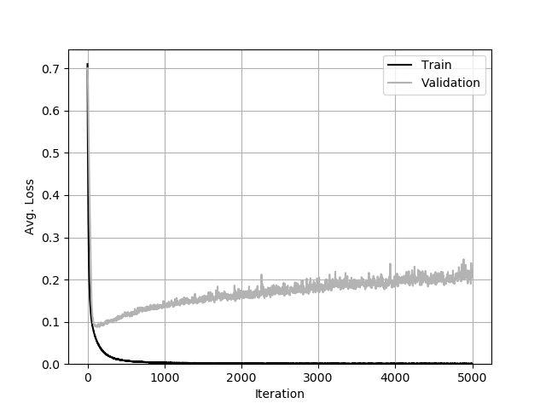
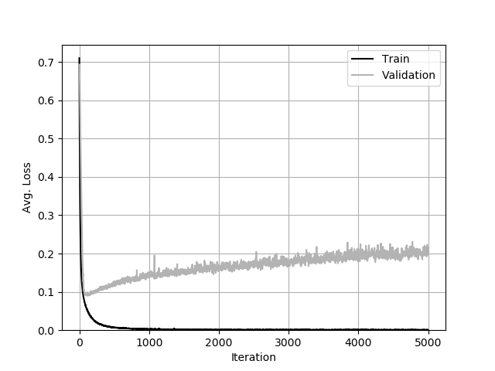
Directed Search
$$F_{1}=5$$
Already did this run, so didn’t bother with $F_{1}=10$
$$F_{1}=20$$
Previous Setting
$$F_{1}=30$$
Parameter Setting #8:
$N_{1}$ – Filter Size Layer 1 → 5x5
$F_{1}$ – Num Filters Layer 1 → { 5, 20, 30 }
$N_{2}$ – Filter Size Layer 2 → 3x3
$F_{2}$ – Num Filters layer 2 → 30
$H$ – Num Hidden Nodes → 30
$D$ – Use Dropout 0/1 → True
Loss Function → BCE
Convergence → 5000 Iterations
Data Processing → Normalize, Flip Augmentation
Test Set Accuracy: 96.83% (with convergence checks)
Next Step:
Residual Power!

Slide 18
Why not use more modern techniques
Add a residual block between convolutional layers
Add Residual Block
Previous Setting
Starting with way too strong a model:
Harder to deal with variance
Less information from each run
Each run slower…
Easier if settings are well behaved
Interpretation:
Too much power
~2x Runtime of other settings
Next Steps:
Take a step back, look at mistakes

Slide 19
Looking at Mistakes
Where are the mistakes:
Closed Left | 17
Closed Right | 26
Open Left | 16
Open Right | 14
Open Right
Open Left
Closed Right
Closed Left
Observations:
Over and underexposed
Grainy
Off-center crops
Harsh shadow
Questionable Labels
Next Step:
You take it from here!
Taken from a single train run across all test folds.

Slide 20
Directed Search Summary
Interpret intermediate results
Apply the right tools in the right situation
Model power
Overfitting prevention
Data improvement
Look at data
Get into a reasonable place for further (grid, random) optimization
Grid search for this parameter space would have taken weeks.
Sample directed search took ~12 hours of runtime
But I sort of knew where to look
Probably take longer on a problem you don’t have experience with

Slide 21
Summary of Model Tuning
Goal: get the highest generalization accuracy you can
Invest in understanding variance in modeling process
Don’t ‘optimize’ into randomness
May require many runs to get signal
Too many parameters to be exhaustive
Need to iterate and interpret
Grid search can help zero in on key parameters, settings
Human intuition key to balance bias variance with data & problem
Look at data!

